Slide 1
Inventory Optimization & Sustainability Analysis
Presented by: Offodum Sandra

Slide 2
Outline
Goal of the Analysis
Top Products at the Beginning & End of year
Bottom Products at the Beginning & End of year
Stock at Hand & Sales
Recommended and Current Inventory
Payment duration and lead time
Conclusion
Recommendation

Slide 3
Goal of the Analysis
Minimize waste by optimizing inventory levels.
Identify the most efficient purchasing strategies based on sales, procurement and inventory data.
Evaluate product sales performance to formulate a sustainable inventory management approach.

Slide 4
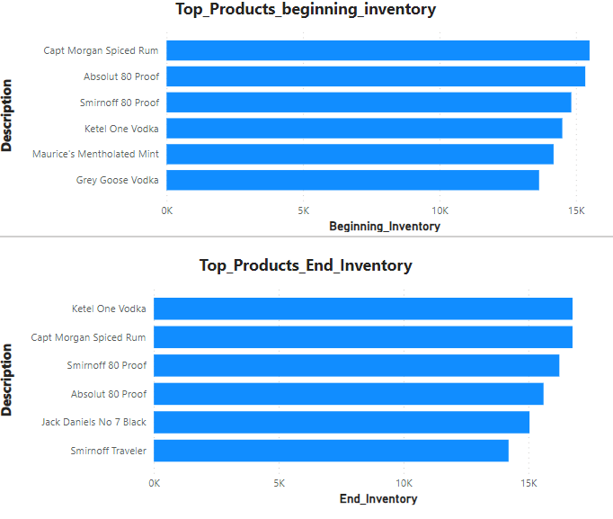
Top Products at the Beginning & End of year
Some products were seen to be at both the beginning and end inventory. "Jack Daniels No 7 Black“ and “Smirnoff Traveler” were only seen at the end inventory. This could imply low sales or higher restocking levels as a result of demand for this product during the year
"Maurice's Mentholated Mint“ and “Grey Goose Vodka” were seen to appear only at the beginning of the year. This could imply more sales or low restocking level for these products.

Slide 5
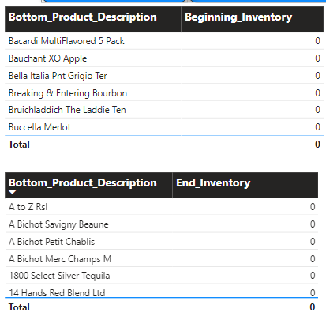
Bottom Products at the Beginning & End of year
The bottom products at the beginning and the end of the year had zero inventory. It's possible that these items either never had stock during the entire year, or they had stock that was completely sold out and never replenished.
There isn't a significant overlap between the products in the bottom 5 of both lists, indicating that inventory for low-stock items could be fluctuating throughout the year.
The presence of wines and niche products among the bottom lists suggests that these might be specialty items with selective demand or limited supply.

Slide 6
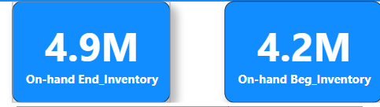
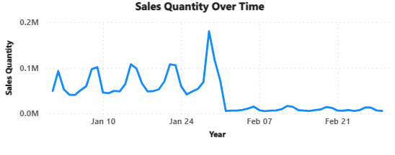
Stock at Hand & Sales
Available inventory increased by the end of the year. This could be as a case of low sales as a sharp decline was observed by ending January

Slide 7
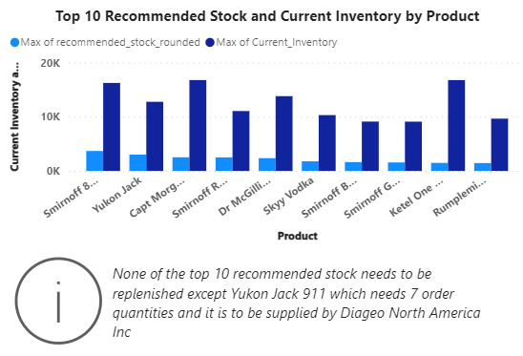
Recommended and Current Inventory
It could be seen that current inventory exceeded recommended inventory for all the product observed. This may lead to higher carrying costs and risk of stock becoming outdated.
However, “Yukon Jack” was observed to need 7 order quantities to meet up with daily sales

Slide 8
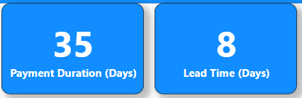
Payment duration and lead time
The average payment duration to vendors and lead time is 35 days and 8 days respectively

Slide 9
Conclusion
Inventory Challenges:
Zero inventory items at year's start and end suggest stocking or demand issues.
Specialty items, like select wines, linger at the bottom, indicating niche demand.
For the top ten products with the highest recommended stock levels, still current stock levels exceeded recommended levels, hinting at overstocking.
Inventory Management Insights:
Strong consistency in top products reflects solid demand forecasting and replenishment.
Recurring zero stock levels could point to deeper inventory procurement flaws.
The recommended and current inventory chart provides valuable insights for inventory management, helping the business prioritize which products to stock more frequently based on their sales rate.
Sales peaked notably on January 25th, then dropped in February.
Average supply duration is 7.62 days, but average payment stretches to 35.66 days.

Slide 10
Recommendation
For the top ten products with the highest recommended stock levels, still current stock levels exceed recommended levels, hinting at overstocking, there is a need to revise purchase orders to align with sales projection to minimize waste
“Yukon Jack” need 7 order quantities to meet up with daily sales
There should be focus on the recommended inventory and its reorder quantity
Marketing campaigns/adverts need to be effective to improve sales
Payment duration to vendors and supply period need to be reviewed to improve the recurring zero order stock levels

